Slide 1

Chapter 15
Connecting LANs,
Backbone Networks,
and Virtual LANs

Slide 2
15-1 CONNECTING DEVICES
In this section, we divide connecting devices into five different categories based on the layer in which they operate in a network.
Topics discussed in this section:
Passive Hubs
Active Hubs
Bridges
Two-Layer Switches
Routers
Three-Layer Switches
Gateways

Slide 3

Connecting Devices
Figure 15.1 Five categories of connecting devices

Slide 4
Passive Hubs
A passive hub is just a connector.
It connects the wires coming from different branches.
This type of a hub is part of the media; its location in the internet model is below the physical layer.

Slide 5
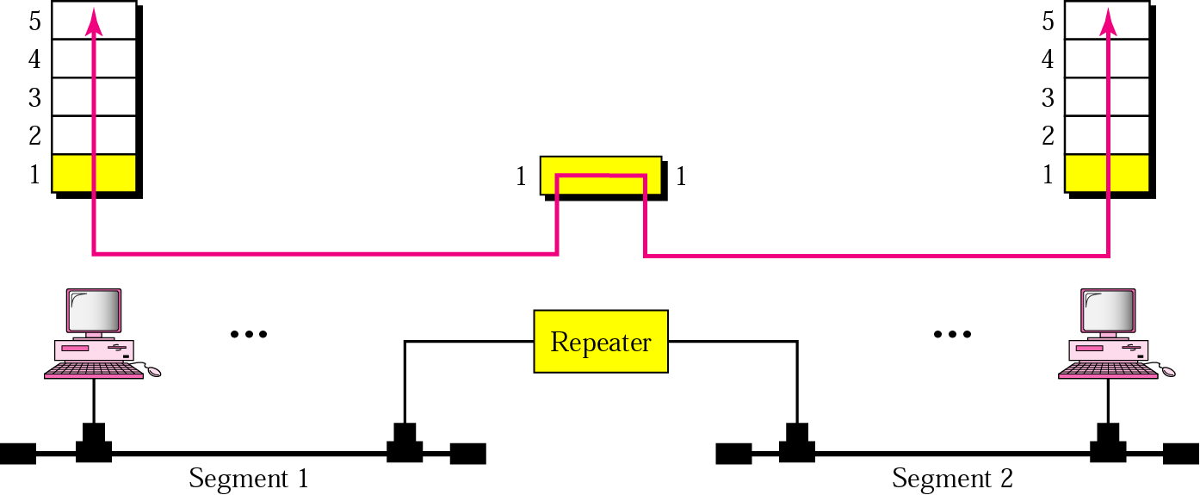
Repeater
Repeater only operates in the physical layer
Repeater regenerates the signal, and can extend the physical length.
Doesn’t connect two LANs, connects two segments of the same LAN

Slide 6
Repeater
A repeater connects segments of a LAN.
A repeater forwards every frame; it has no filtering capability
A repeater is a regenerator, not an amplifier.

Slide 7
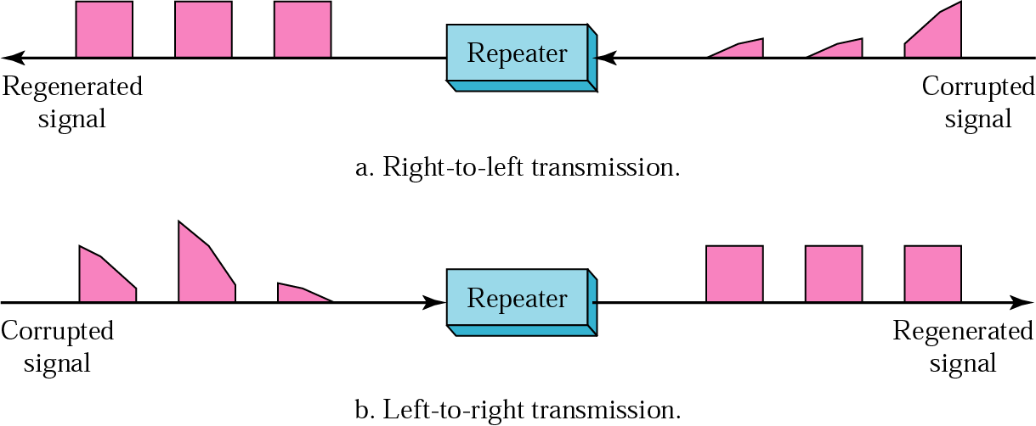
Function of Repeater
Must be placed so that a signal reaches it before noise changes
the meaning of its bits

Slide 8

Active Hubs
Hub is a multiport repeater
Creates connections between stations in a physical star topology

Slide 9
Bridge
Bridge operates in both the physical and the data link layers
As a physical layer device, it regenerates the signal
As a data link layer device, it checks the physical (MAC) addresses
A bridge has a table used in filtering decisions.

Slide 10

Bridge
Figure 15.6 A bridge connecting two LANs

Slide 11
Transparent - Bridge
A bridge does not change the physical (MAC) addresses in a frame.
Transparent Bridge
  Bridge in which stations are completely unaware of the bridge’s existence
  System equipped with transparent bridges must meet three criteria (IEEE 802.1d):
    Frames must be forwarded from one station to another
    Forwarding table is automatically made by learning from movements
    Loops must be prevented

Slide 12

Learning - Bridge
Figure 15.7 A learning bridge and the process of learning

Slide 13
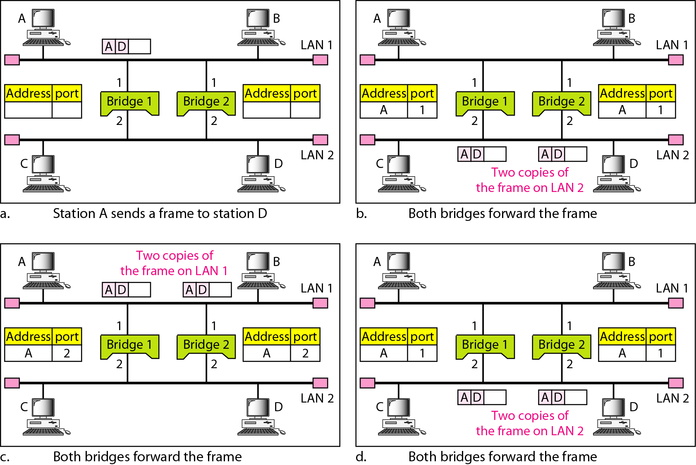
Loop Problem
Figure 15.7 Loop problem in a learning bridge

Slide 14
Spanning Tree
A spanning tree is a graph in which there is no loop.
In a bridged LAN, this means creating a topology in which each LAN can be reached from any other LAN through one path only (no loop).

Slide 15
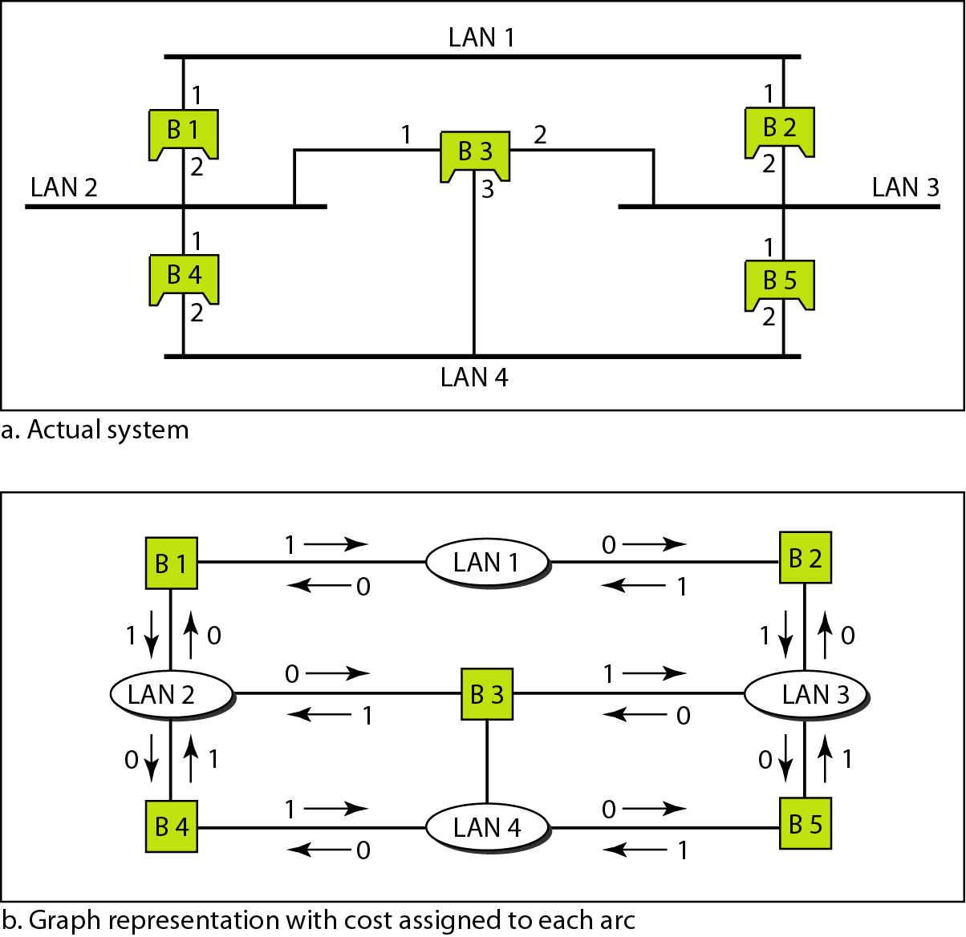
Spanning Tree
Figure 15.8 A system of connected LANs and its graph representation

Slide 16
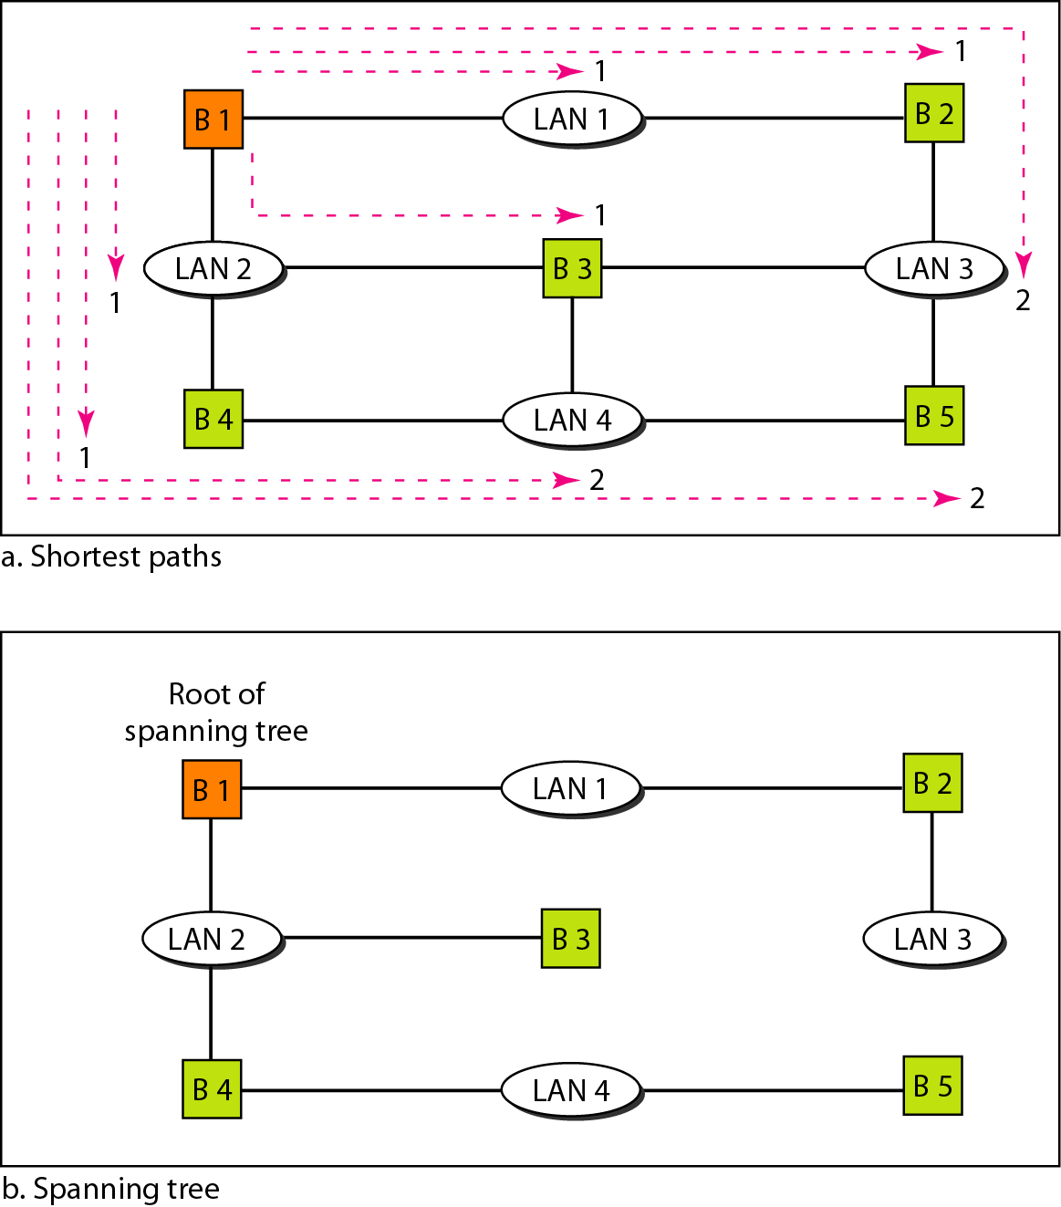
Spanning Tree
Figure 15.9 Finding the shortest paths and the spanning
tree in a system of bridges

Slide 17

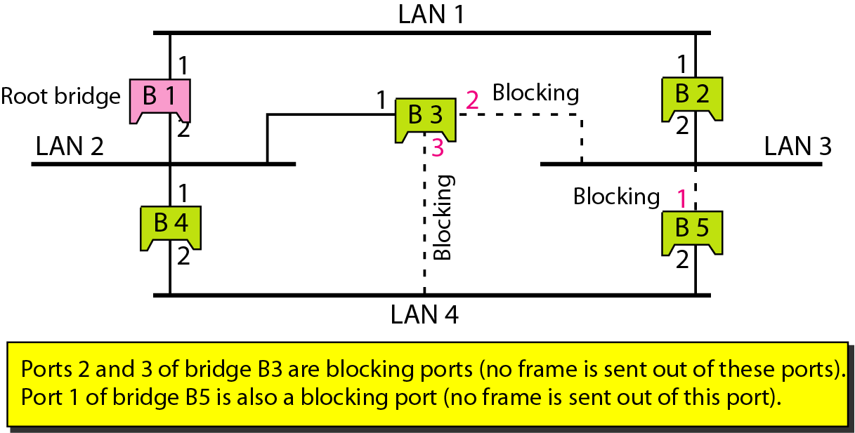
Forwarding ports and blocking ports
Dynamic algorithm – spanning tree algorithm is done dynamically with software in the bridge
using Bridge Protocol Data Unit (BPDU)
Figure 15.10 Forwarding and blocking ports after using spanning
tree algorithm

Slide 18
Bridges Connecting Different LANs
Bridge should be able to connect LANs using different protocols, issues to be considered:
  Frame format – Ethernet vs. wireless frame
  Max data size – too large fame must be fragmented into several frames and no protocol at the data link layer allows for fragmentation and reassembly of frames
  Data rate – each LAN has its own data rate
  Bit order – some send most significant bit first, some send least significant bit first
  Security – wireless has security measures at the data link layer, Ethernet does not
  Multimedia support – some support, some do not

Slide 19

Router
Figure 15.11 Routers connecting independent LANs and WANs
A router is a three-layer device that routes packets based on
their logical addresses (host-to-host addressing).
A router normally connects LANs and WANs in the internet and
has a routing table that is used for making decisions about the route.
The routing tables are normally dynamic and are updated using routing
protocols.

Slide 20
Gateway
A gateway is a normally a computer that operates in all five layers of the internet or seven layers of OSI model.
A gateway takes an application message, reads it, and interprets it.
This means that it can be used as a connecting device between two internetworks that use different models.
  For example, a network designed to use the OSI model can be connected to another network using the internet model.

Slide 21
15-2 BACKBONE NETWORKS
A backbone network allows several LANs to be connected. In a backbone network, no station is directly connected to the backbone; the stations are part of a LAN, and the backbone connects the LANs.
Topics discussed in this section:
Bus Backbone
Star Backbone
Connecting Remote LANs

Slide 22
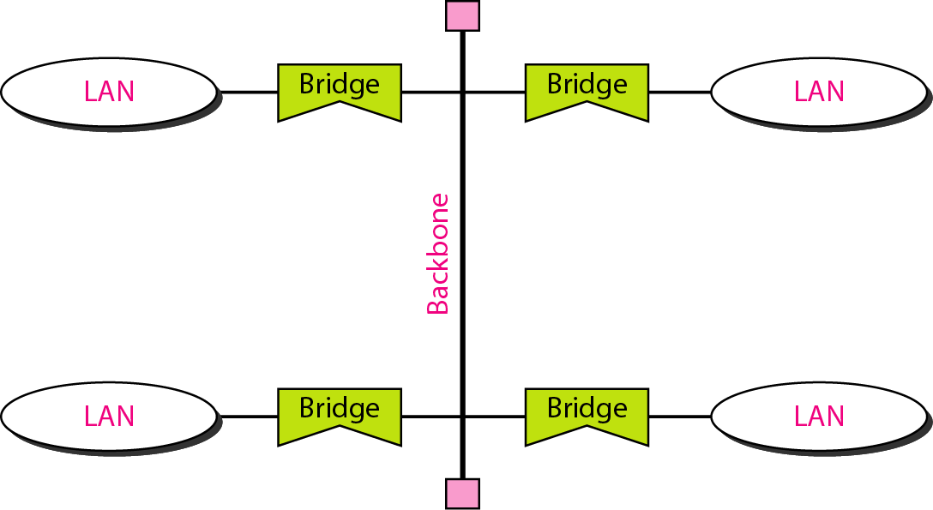
Bus Backbone
In a bus backbone, the topology of the backbone is a bus.
Normally used to connect different buildings in an organization
Bridge blocks frames sent internal to the LAN
Backbone receives frame if going from one LAN to another

Slide 23
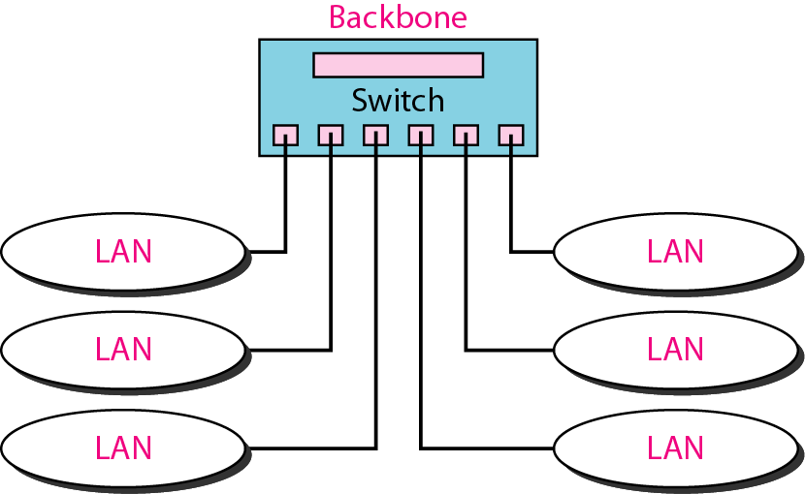
Star Backbone
In a star backbone, the topology of the backbone is a star; the backbone is just one switch.
Used as distribution backbone inside a building

Slide 24
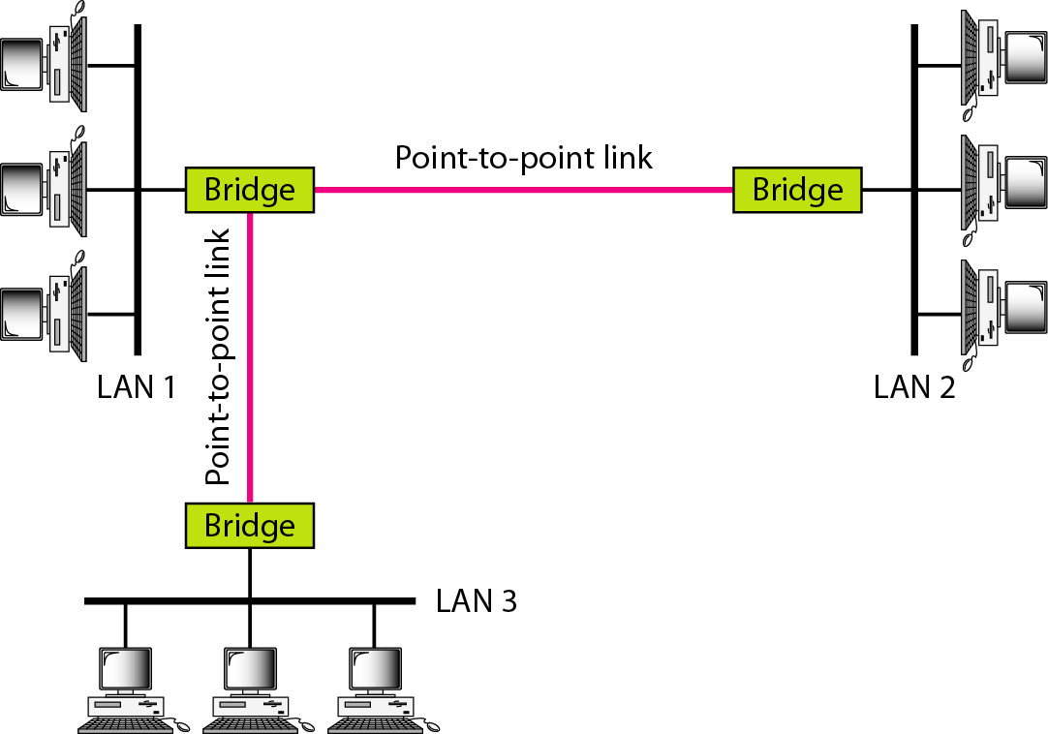
Connecting remote LANs
A point-to-point link acts as a LAN in a remote backbone connected by
remote bridges.

Slide 25
15-3 VIRTUAL LANs
We can roughly define a virtual local area network (VLAN) as a local area network configured by software, not by physical wiring.
Topics discussed in this section:
Membership
Configuration
Communication between Switches

Slide 26
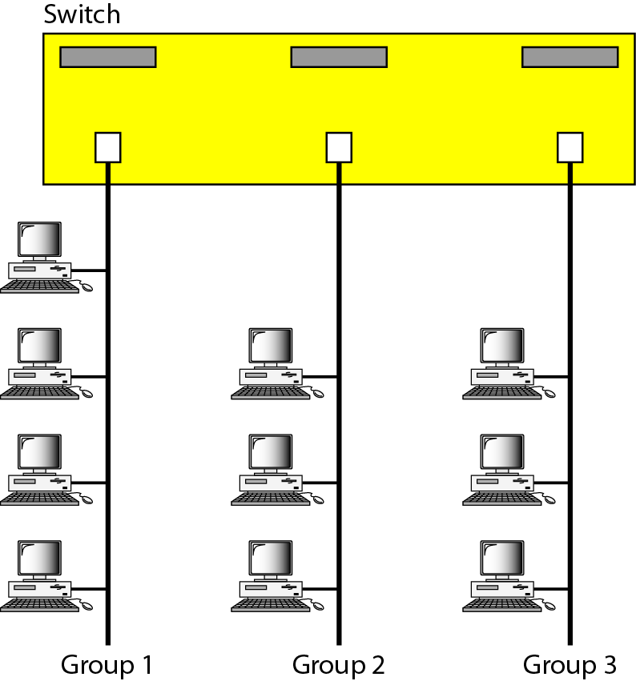
Virtual LANs
Figure 15.15 A switch connecting three LANs

Slide 27

Virtual LANs
Figure 15.16 A switch using VLAN software

Slide 28

Virtual LANs
Figure 15.17 Two switches in a backbone using VLAN software

Slide 29
Summary
A repeater is a connecting device that operates in the physical layer of the Internet model. A repeater regenerates a signal, connects segments of a LAN, and has no filtering capability.
A bridge is a connecting device that operates in the physical and data link layers of the Internet model
A transparent bridge can forward and filter frames and automatically build its forwarding table.
A bridge can use the spanning tree algorithm to create a loopless topology.
A backbone LAN allows several LANs to be connected.
A backbone is usually a bus or a star.
A virtual local area network (VLAN) is configured by software, not by physical wiring.
Membership in a VLAN can be based on port numbers, MAC addresses, IP addresses, IP multicast addresses, or a combination of these features.
VLANs are cost- and time-efficient, can reduce network traffic, and provide an extra measure of security.

Slide 30

Questions !

